Slide 1

Bella beta Case Study
Google data analytics capstone project BY: NIDARSHANA R R

Slide 2
BUSINESS TASK
Analyze smart device usage trends using Fitbit dataset from Kaggle and provide actionable insights and marketing recommendations to bella beta to improve their marketing strategy and user engagement.

Slide 3
Insights Concluded
Key Questions :
What are some trends in smart device usage?
How could these trends apply to Bella beat customers?
How could these trends help influence Bella beat's marketing strategy?
Key Insights :
Users who sleep 7+ hours per night are more active the next day.
There is a strong correlation between steps taken and calories burned.
The majority of users are sedentary, with very few engaging in high-intensity activity.
Monthly trend based the total steps by users.

Slide 4
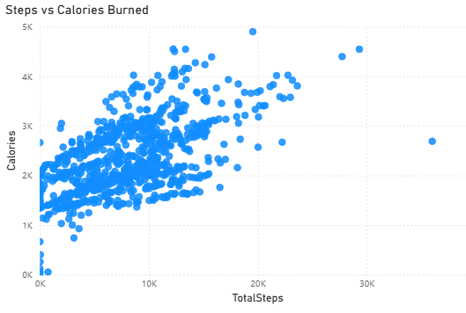
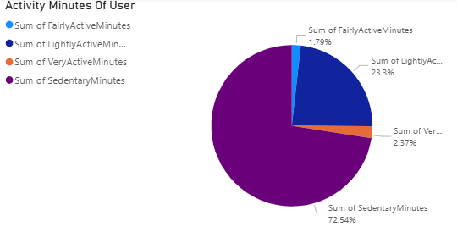
There is a strong correlation between total on of steps taken by user on a particular date and calories burned. Conclusion: more steps leads more calories burn.
Activity minutes is categories as
FairlyActiveMinutes
LightlyActiveMinutes
VeryActiveMinutes
SedentaryMinutes
Refers user’s activity status per day
Conclusion: majority of the time per day user’s being inactive

Slide 5
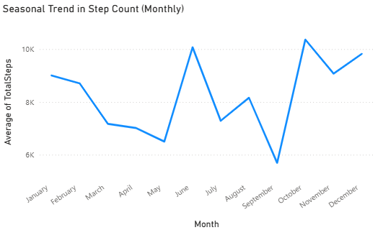
Big drop in August and rise in May.
Conclusion: seasonal drop is noticed so try keeping customer engaged by add new feature such as reminders and
to-do list.
Power BI Visualization :case study vis.pbix

Slide 6
Recommendation
Target marketing for Leaf device toward users with low activity or poor sleep
Create reminder features in the app for staying active
Launch seasonal challenges during months of low activity (e.g., March–May)

